Slide 1
Maternity Leave
A Lightning Talk
by Ellen Blumhardt

Slide 2
What does it consist of?
Family Medical Leave Act (FMLA) of 1993
Up to 12 weeks of unpaid leave for birth, adoption, or medical reasons concerning the employee or his/her family member
Requires that the employee has been a part of the company for 12 months
The company must have at least 50 employees within a 75 mile radius
Benefits
3 months is usually enough time for the mother to physically recover from childbirth
Allows mothers and the sick to return to their job after recovery
Gives mothers some time to bond with their baby
Notes:
FMLA is our only national law regarding maternity leave
-My grandmother, although she probably would have stopped working anyway, had to quit teaching in public school as soon as her first pregnancy began showing

Slide 3
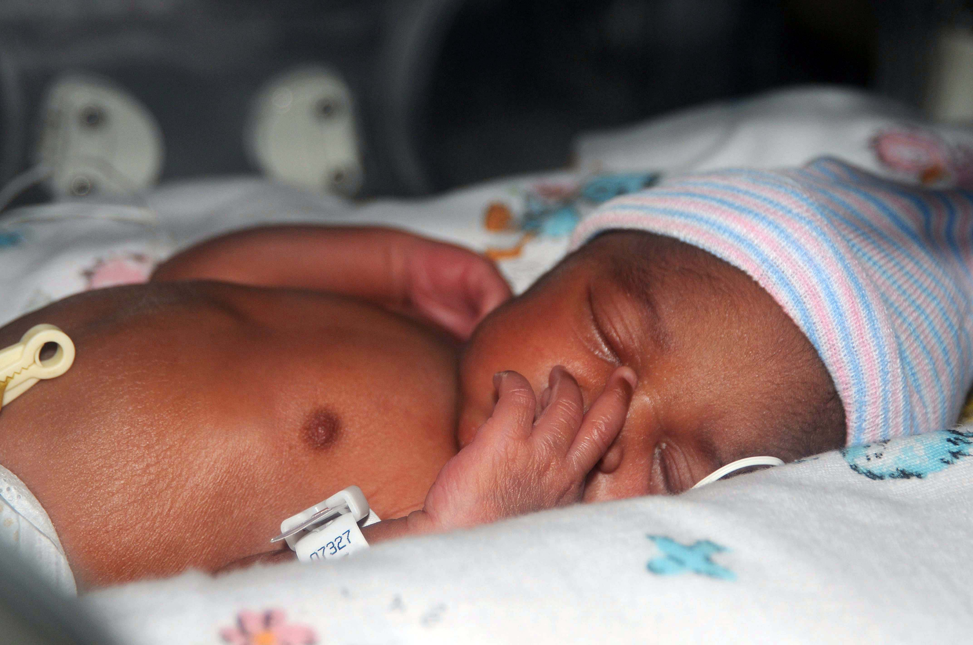
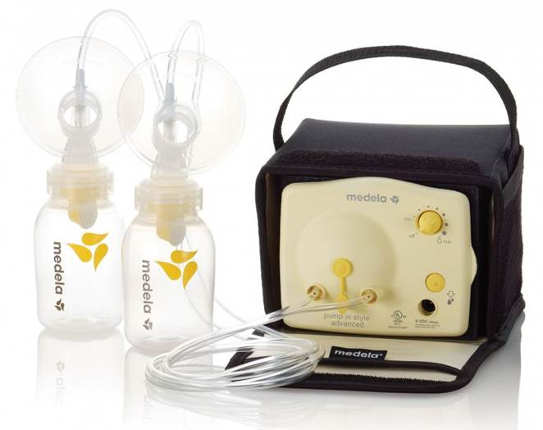
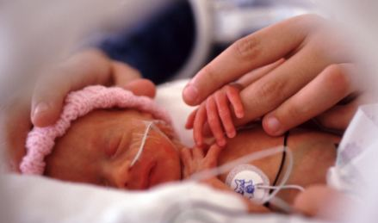
So what’s wrong with that?
First Clue: We are the only developed country in the world that offers no paid maternity leave
Mother and Baby Health
Breastfeeding
Post-partum depression/anxiety
Premature babies
$$$ Daycare is Expensive $$$
$210 for in-home, $340 for center
More for a nanny
Additional Issues for Music Teachers
Difficult to find a music substitute
Students have to adjust to having two
different teachers in the course of a year
≠
Notes:
Does not account for whether the baby is premature – if baby is 6 weeks early, the mother may have to return to work on her baby’s due date while the baby is at best as healthy as a full-term newborn
Problems with giving birth later in life:
-Higher risk of having pregnancy complications, such as gestational diabetes, preeclampsia, high blood pressure
-higher risk of C section, low-birth weight
-Higher risk of Down Syndrome
-stillbirth or maternal death

Slide 4
“This is Wrong”
We went through multiple caregivers in the course of 6 months
Francis needed Mommy
would not take bottles during the day for 6 weeks, stopped gaining weight
cried frequently and for long periods of time
It improved once we found a good caregiver and when we had adjusted, but still hard
Nearly every working mother I talked to shared a similar story
Notes:
-It was like I finally was in on some secret. I heard from countless coworkers and family members about their own emotional struggle. I had never heard in my life about how hard it was (other than people saying that they cried when they dropped their kid off from daycare). I always assumed that I would be ok with being a working mom if I needed to be.
-Every single person expressed empathetic relief (or honesty about their jealousy) when I said that I was not returning to work the following year.

Slide 5
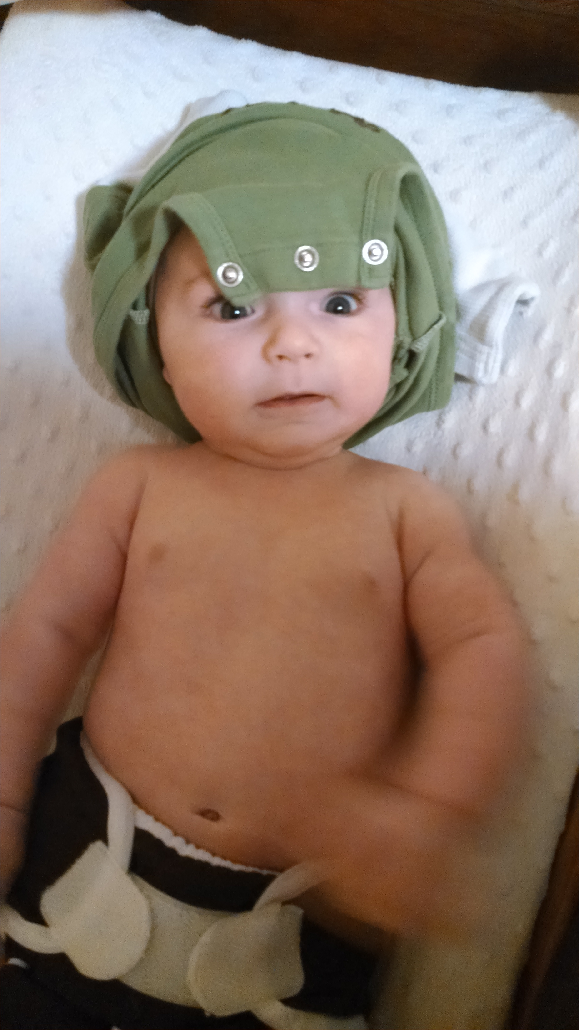
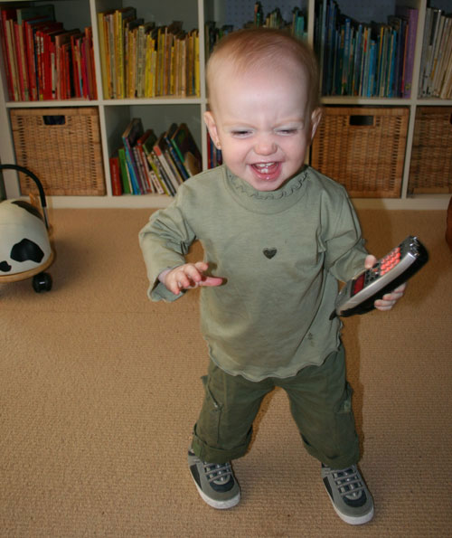
What We need
Honest and frank discussion from women about what it’s like to go back to work
A full time music substitute for each school district
Paid leave for 1 year
A change in our culture’s attitude toward mothers
VS
Notes:
Comparison of baby at 3 months vs. 1 year
3 months:
-can’t roll over; confined to whatever position their caregiver puts them in
-for babies like Francis, they need to be held constantly to be happy and to see their world
-also at the mercy of other babies and children
-are exclusively on breastmilk or formula diet; need to eat about every two hours during working hours
-still have undeveloped immune system
-unable to interact with peers
1 year:
-mobile; can decide where they go, what they play with
-better at communicating needs to caregivers
-eating solid foods and able to go longer between feedings
-able to play and interact with other babies/toddlers
Attitudes towards Mothers
-“they just need to suck it up and do it; they’re the ones who got pregnant” – sexism
-viewing being a stay-at-home mother as not being a job
-acknowledgement of the impossible task of balancing work and family (what my day looked like)

Slide 6
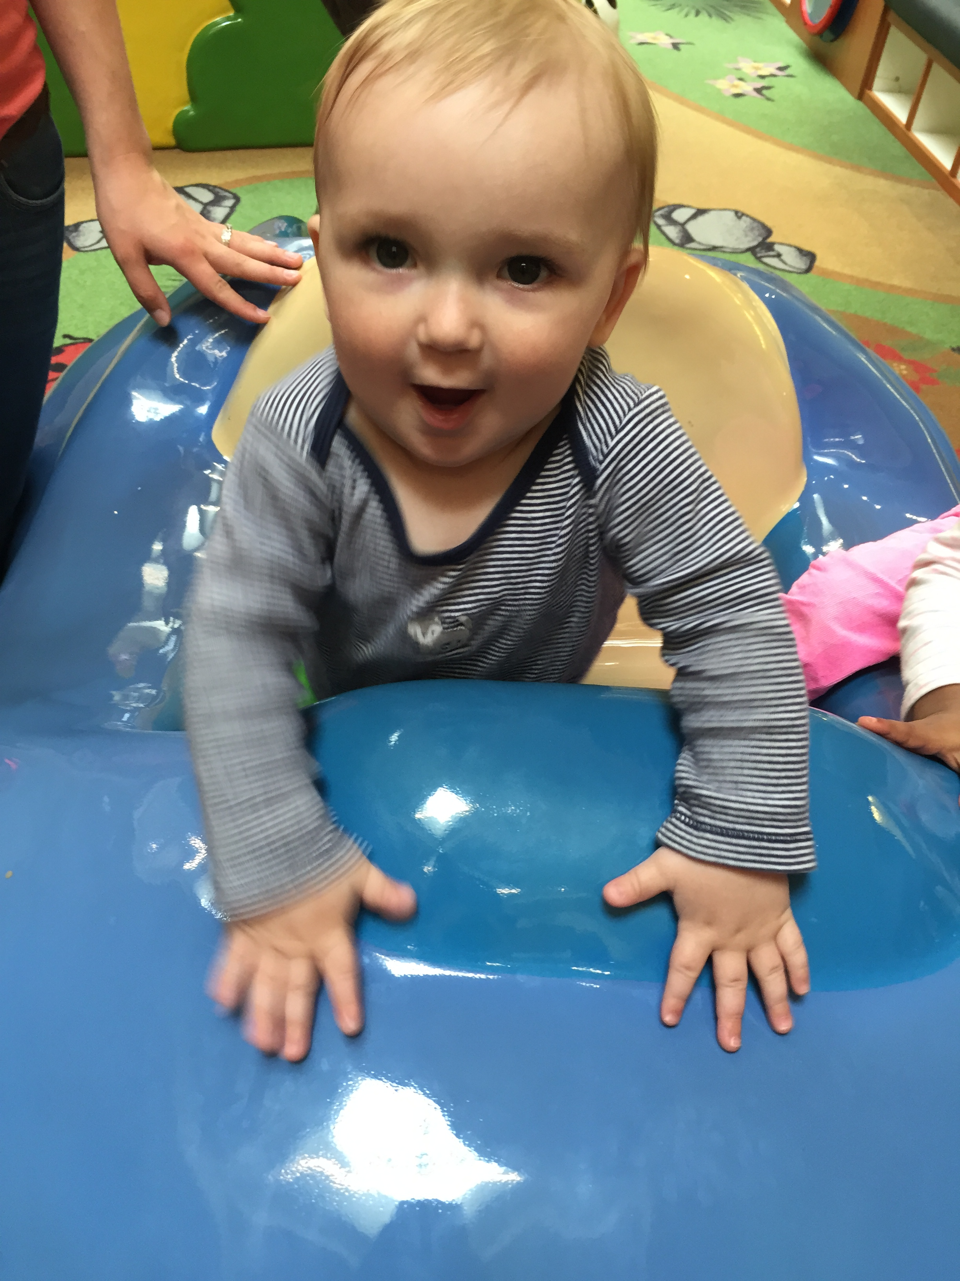
“that would be like paying people to get pregnant!”
Notes:
I could talk about how our nation’s birth rate is lower than 2 per woman and how that does not bode for a good future or how Europe is already taking measures to increase its birth rate to keep their economy from dropping in future decades, but instead I’m going to just show you a picture of a cute baby.

