Slide 1
Brett Bigham, Oregon’s Teacher Of The Year!

Slide 2
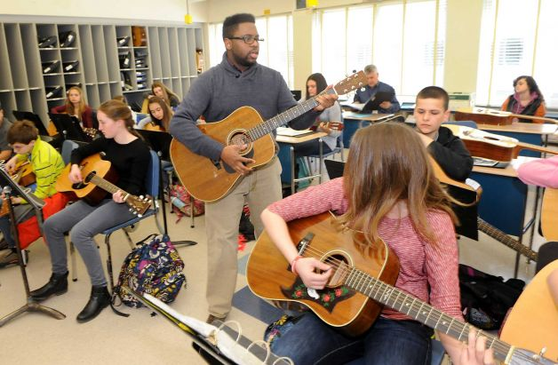
Privileges of Heterosexual Music Teachers
Reveal Their Orientation
Lie
Share Nothing

Slide 3
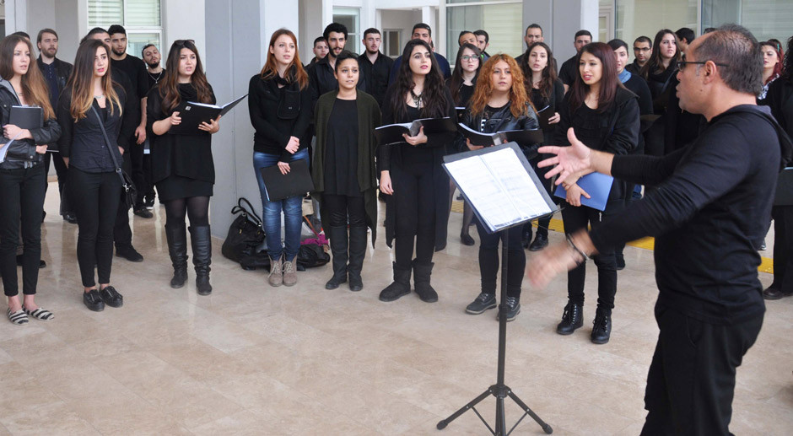
Ambiguous Pronouns
Accused Of “Promoting The Heterosexual Lifestyle"
Administration/Parents Upset that You Talked About Your Life Partner

Slide 5
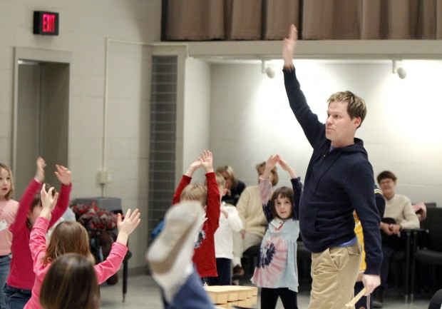
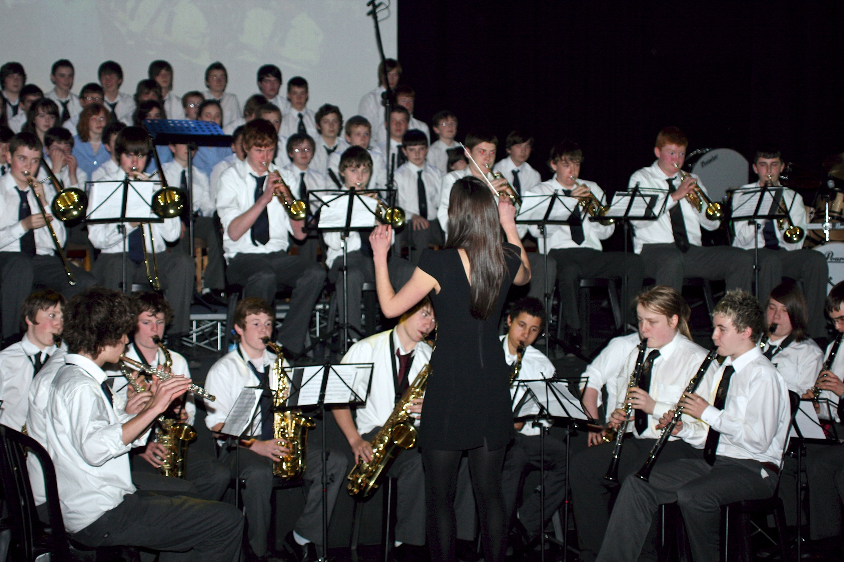

Slide 6
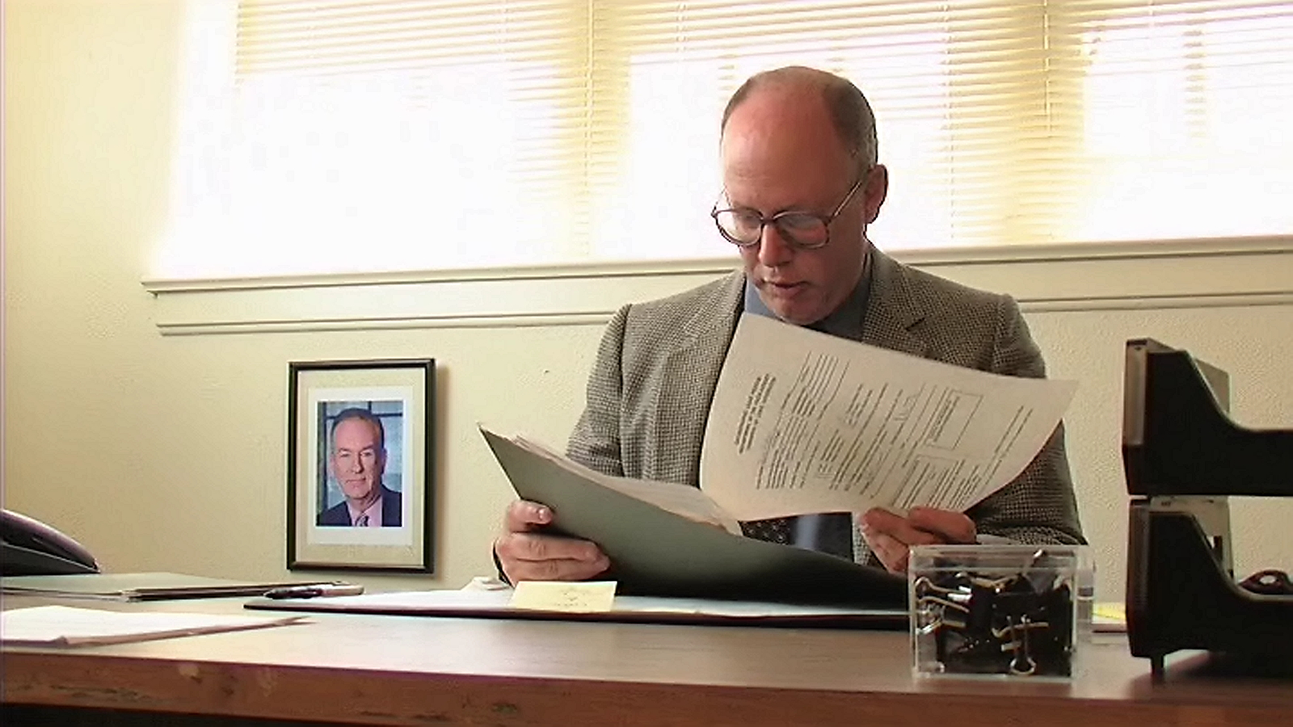

Slide 7
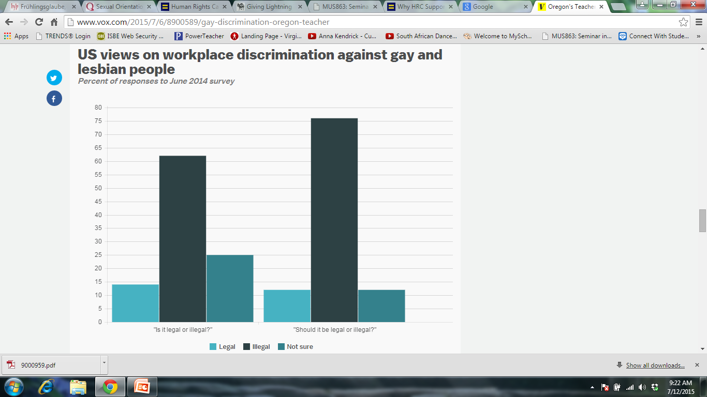

Slide 8
Inclusion:
1. the action or state of including or of being included within a group or structure.
Sources:
Sexual Orientaion and Music Education: Continuing a Tradition By Louis Bergonzi
www.vox.com/gay-discrimination-oregon-teacher
http://www.vocativ.com/culture/lgbt/lgbt-rights-kansas/
http://www.latimes.com/nation/la-na-gays-employment-20150626-story.html#page=1

