Slide 1
Shining light on the charter school perspective

Slide 2
Pros & Clarifications
(1CP) It is a school of choice
(2CP) Contrary to popular belief, charter schools are free and are publicly funded
(3CP) Increased innovation to better fit the needs of students
(1UP) Public charters are required to meet all state and federal education standards
(2UP) Florida charters are not stand-alone organizations
(3UP) are open to any student, inter-district or residing in the school district
(4UP) some do benefit minorities & poor families

Slide 3
“good & Bad Hair” Spike Lee’s school daze
“good families”
“rich neighborhoods”
“good kids”
High income families and families that own companies & businesses are not necessarily good & happy
Charter Schools DO NOT charge admission or tuition
Parents send their kids to school and very few middle school kids are the ‘good kids’ parents believe them to be
We are not stealing …

Slide 4
Charter school trend… “I needed a job.”
A fulltime job for you, a fulltime job for me, a fulltime job for Music Educators in your state & district because traditional public schools don’t want us!!!!

Slide 5
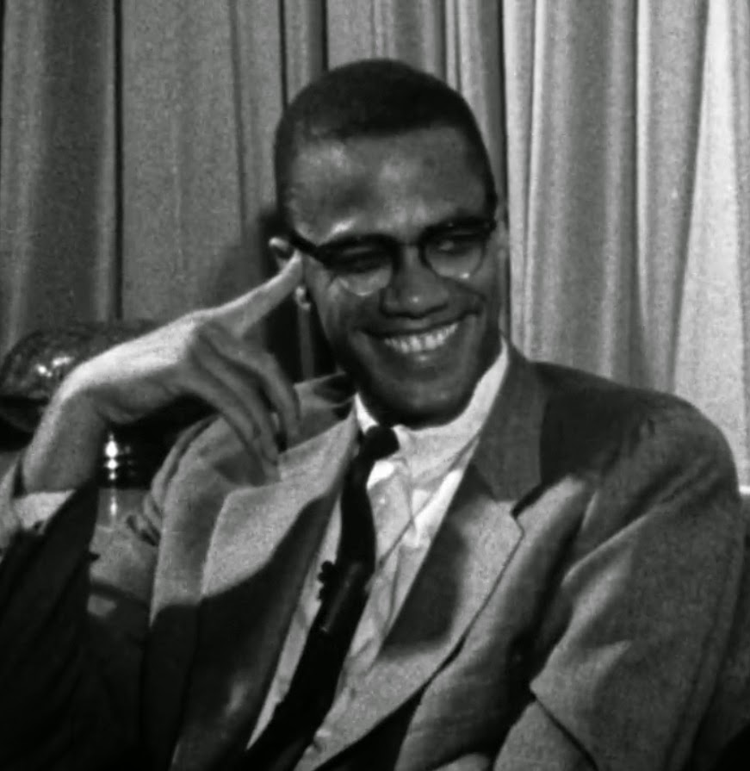
I am not educated nor am I an expert in any particular field... but I am sincere and my sincerity is my credential.
From Brother Malcolm X

Slide 6
“good & Bad Hair” Spike Lee’s school daze
“good families”
“rich neighborhoods”
“good kids”
High income families and families that own companies & businesses are not necessarily good & happy
Charter Schools DO NOT charge admission or tuition
Parents send their kids to school and very few middle school kids are the ‘good kids’ parents believe them to believe
We are not stealing …

Slide 7
I Leave you…
3 MAJOR POINTS
Charter schools are growing in an attempt to diversify their populations
Make an IMPACT wherever you go- traditional, charter, private
It’s a Music job- pay your bills;-)

Slide 8
Cites to refer to
Charter Schools USA Company
www.charterschoolsusa.com
The Center for Education Reform
https://www.edreform.com
Florida Consortium of Public Charter Schools
http://floridacharterschools.org/schools
Florida Charter School Alliance
www.flcharteralliance.org
Charter School Improvements
www.ed.gov
www.kipp.org
National Center for the Study of Privatization in Education
www.ncspe.org
WYNC
http://www.wnyc.org/story/behind-pro-charter-school-group-fighting-de-blasio/

