Slide 1
Accessible teaching tools to inspire ownership and relevance in the young orchestra classroom
Kristen Terreri
MUS 863

Slide 2
Orchestra programs and teachers…

Slide 3
OUT OF TOUCH

Slide 4
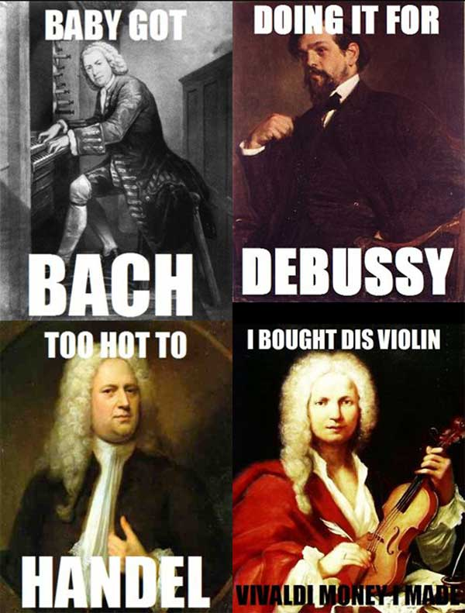
DEAD WHITE GUYS…

Slide 5
Our actual population…

Slide 6
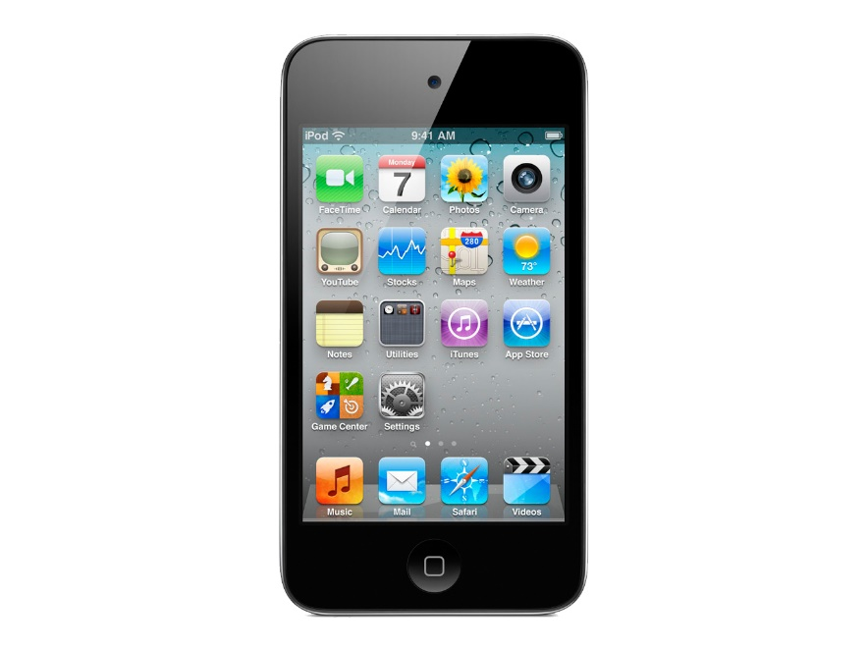
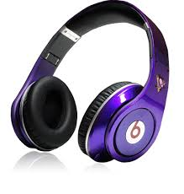
MODES OF LISTENING

Slide 7
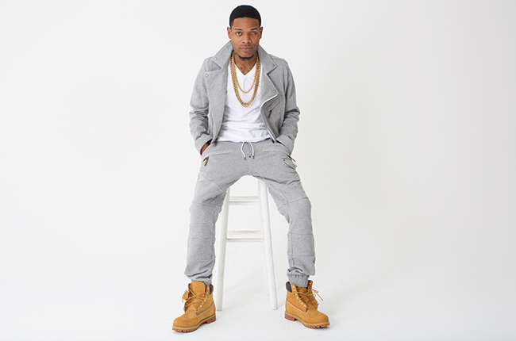
Reppin’ the pop music, people…

Slide 8
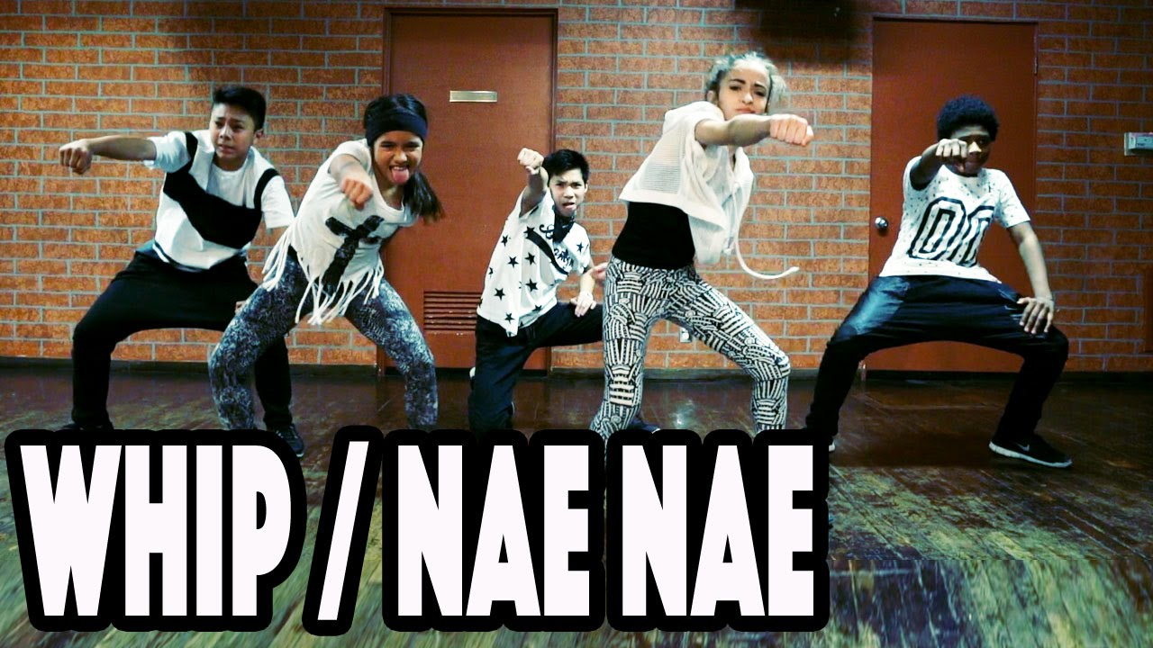
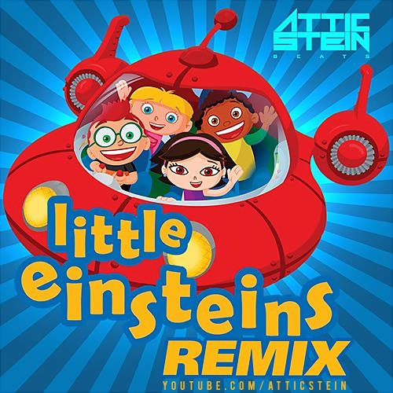
Student Talent Showcase this year =…
To….

Slide 9
WELL NOW WHAT???!

Slide 10
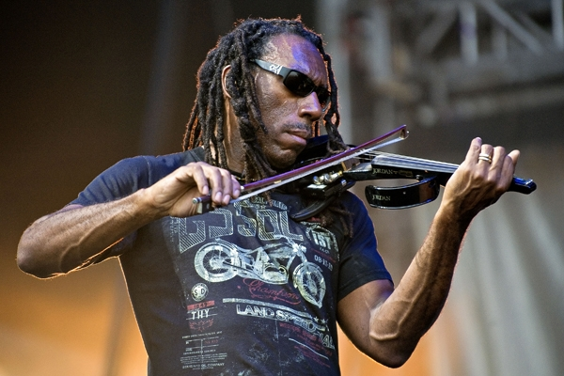
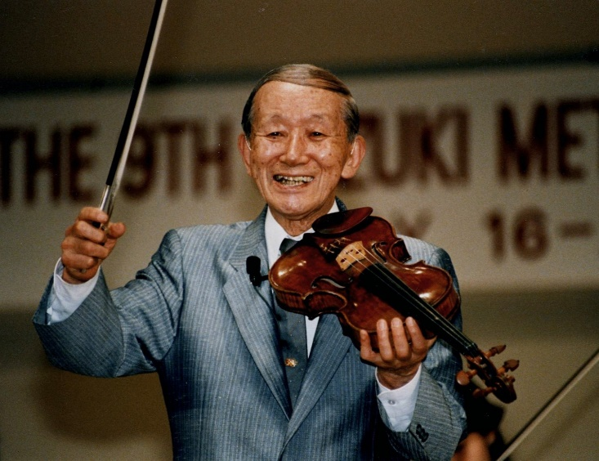
Let’s meet in the middle…
PLUS

Slide 11
TOOL BOX

Slide 12
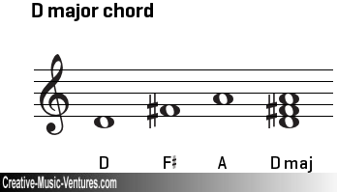
IMPROVISE!

Slide 13
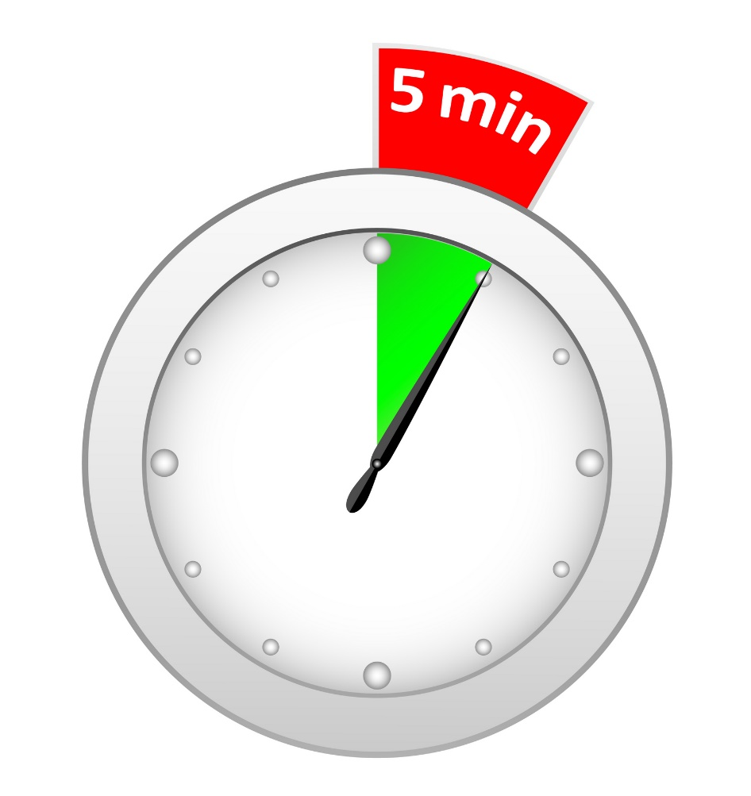
A little a day…

Slide 14
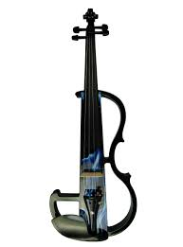
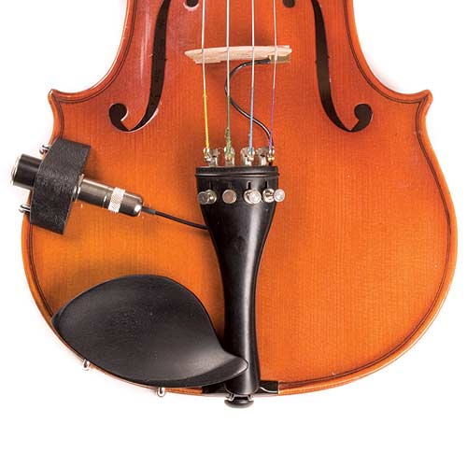
Electrify..
On a budget?....

Slide 15
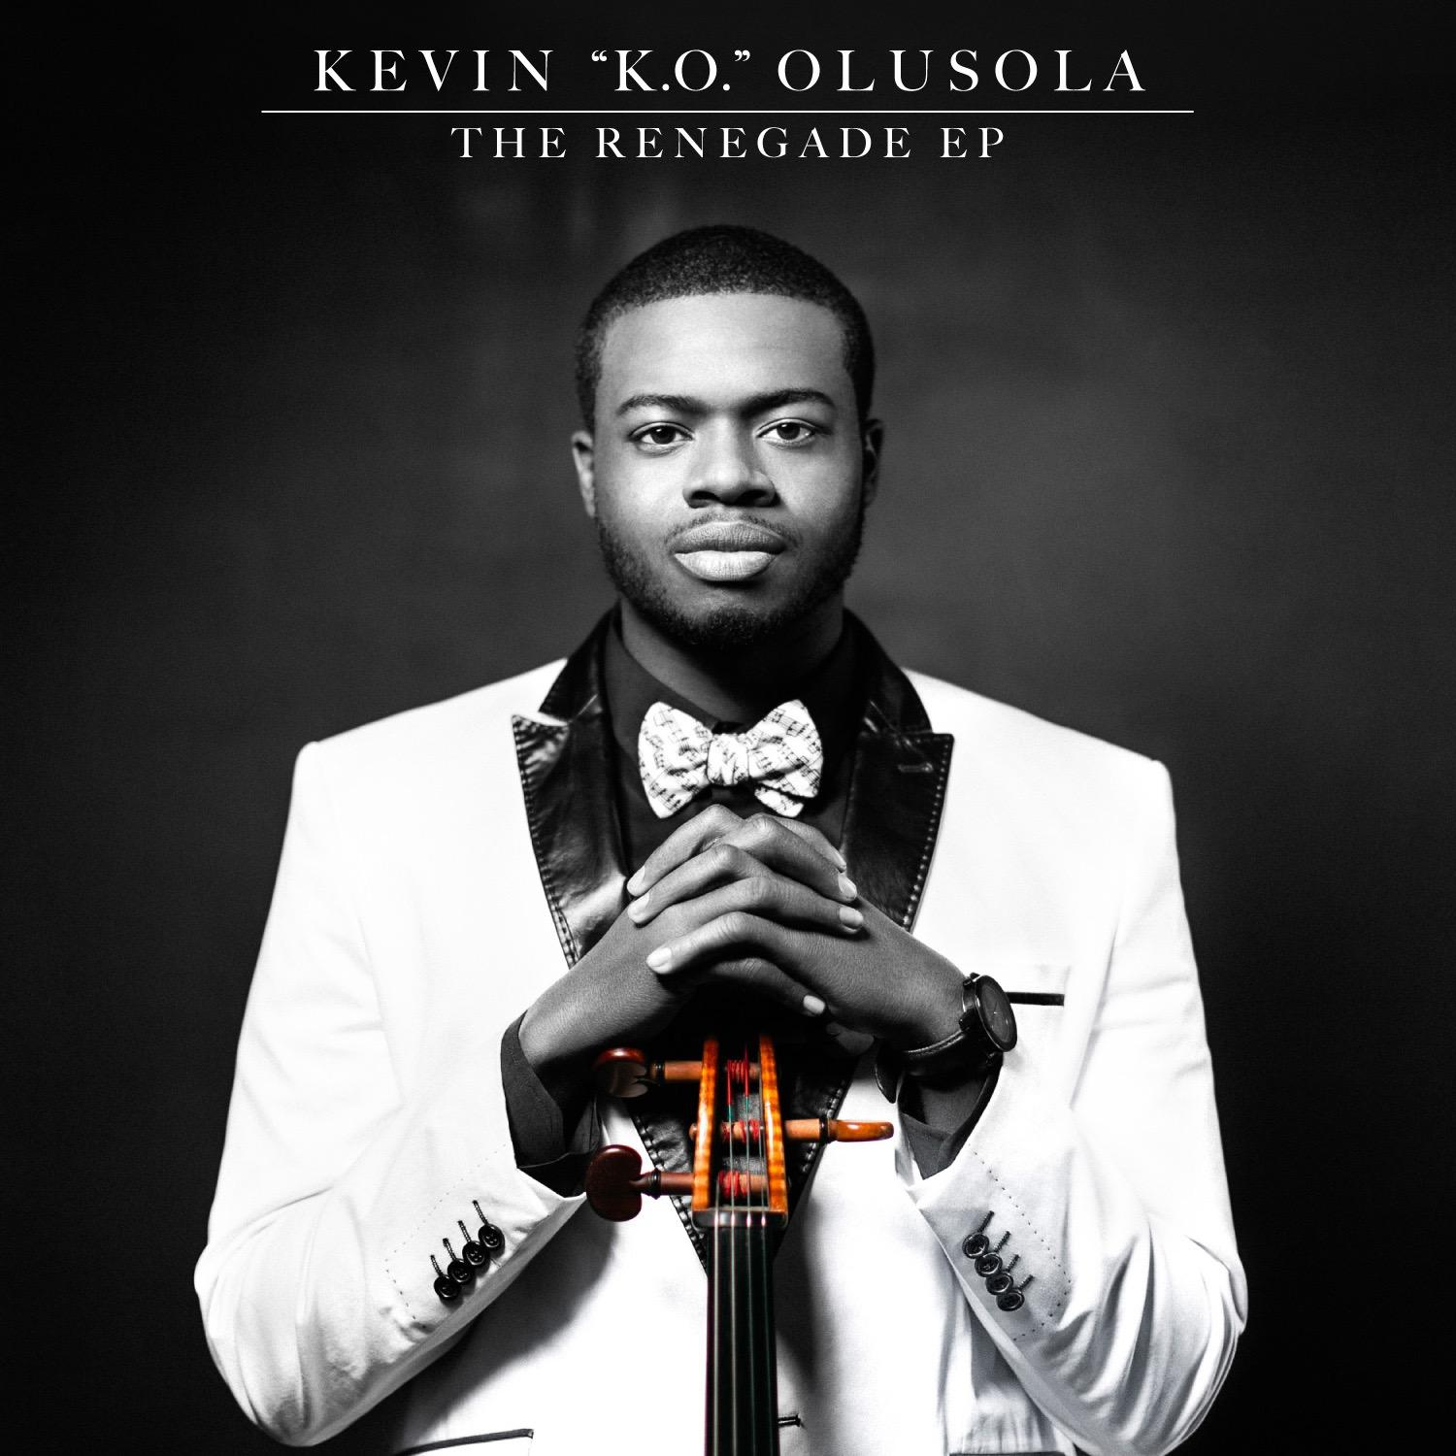
YOU TUBE FRIDAYS

Slide 16
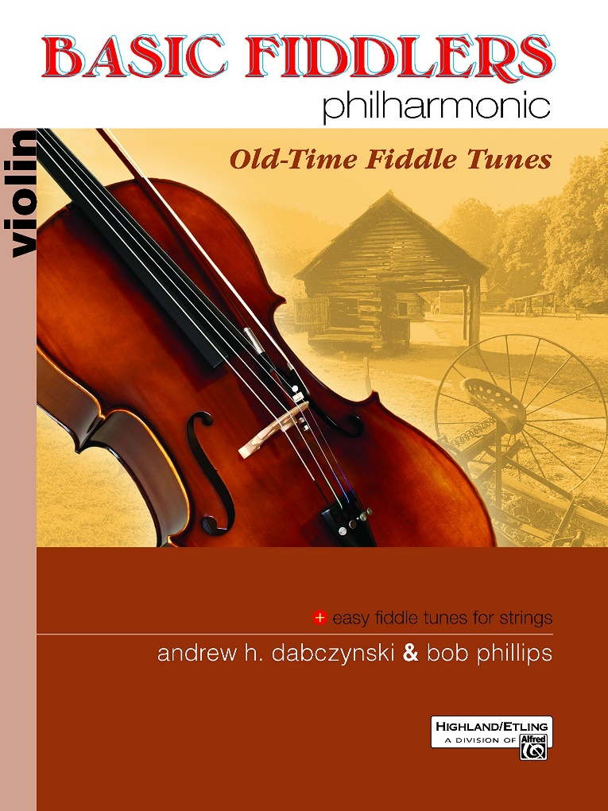
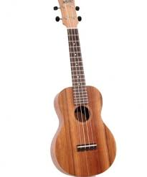
Fiddler’s Philharmonic

Slide 17
Compose!

Slide 18
YOUR TURN!

