Slide 1
Teacher Evaluations: Do We Fit the Mold?
Claire Strachan

Slide 2
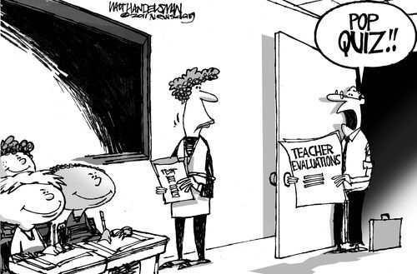
What is the Purpose?
Improve Instruction
Increase Accountability
Test Scores

Slide 3
“Check Up”
2, 2, 1, 1, 0, 0, 1, 0, 0, 1
Knowledge of Pedagogy
Student Assessments
Culture for Learning
Classroom Space
Professionalism

Slide 4
Story Time…

Slide 5
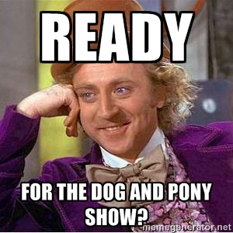
How Does THAT help?

Slide 6
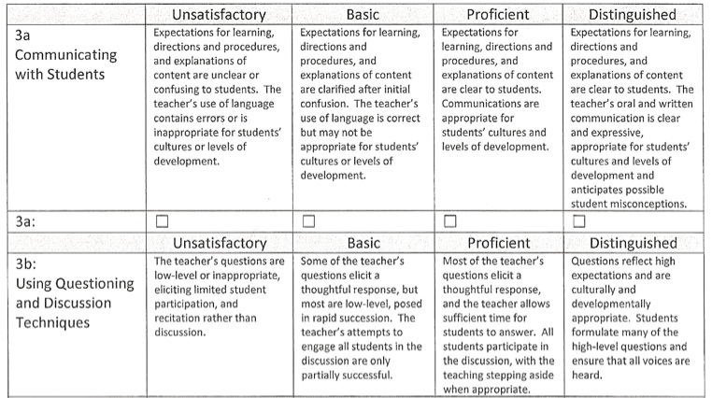
Options to Improve

Slide 7
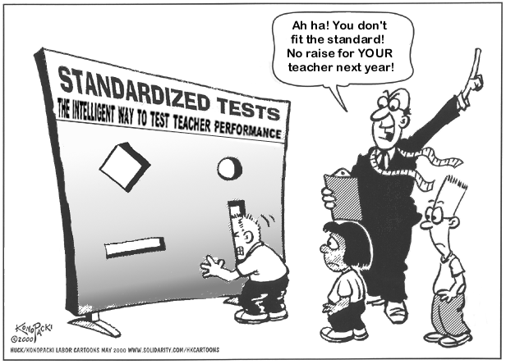
Can We Create Our Own Mold?

