Slide 1
Empowering
Students

Slide 2
Empowerment
Student Control
Student Ownership
Student Responsibility
Student Leadership

Slide 3
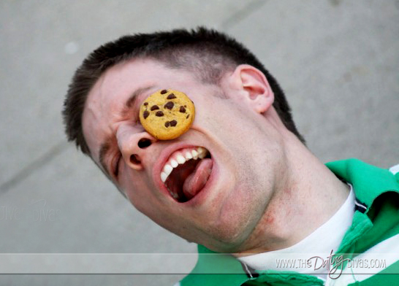
Leadership?

Slide 4
Responsibility
Social Contracts
Section Leaders
Warm-Ups
Attendance
Passing out Music
Collecting Office Passes
Running Slide Show
Helping New Students

Slide 5
Choices
Musical Repertoire
Recordings
Vote
Musical Games
Fun Friday

Slide 6
Evaluation
Concerts
Rehearsals
Music
CHECK
DELTA

