Slide 1
Michigan School Funding:
It’s Complicated…..

Slide 2
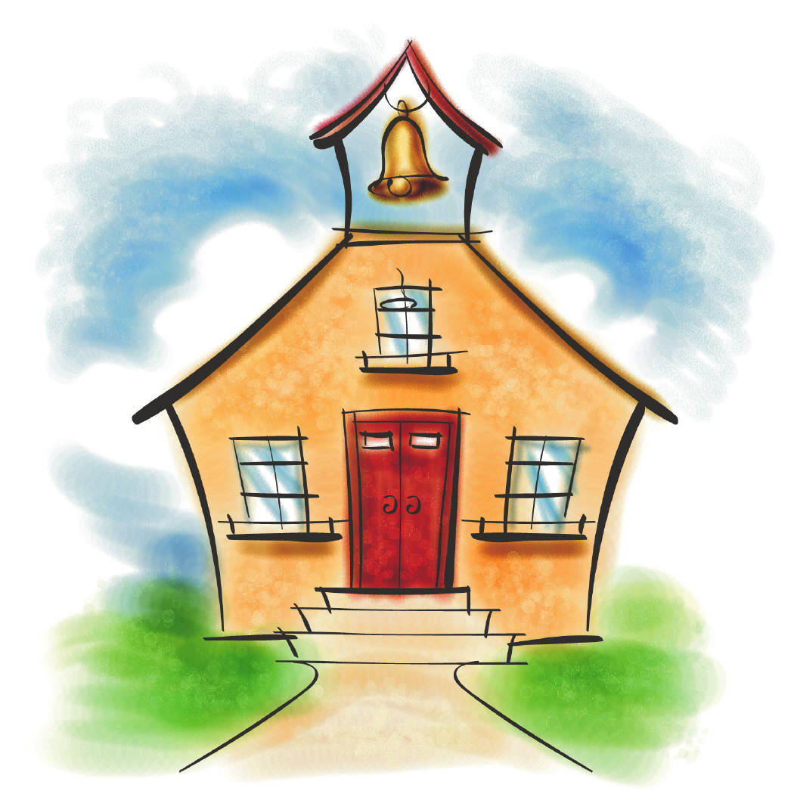
Pre-Proposal A (before 1994)
Local Taxes
School Aid Fund
School Budget Breakdown:
Local Taxes: 69%
School Aid Fund: 31%
Notes:
LOCAL TAXES:
Created in equity amongst districts—socioeconomics
Average property tax was levied at 35 mills
This was determined at the local level
Local taxation accounted for 69% of the state/local split of school finances.
SAF:
Funded mainly by sales tax (@4%)
Cigarette Tax
Lottery
31% of state/local split of school finances
THE PROBLEM:
Schools with a high tax base received substantially more funding that schools in lower income or rural areas.

Slide 3
Proposal A (1994)
Why did we need Proposal A?
What Changed?
Local taxation
State tax revenue
Per-pupil funding
Notes:
WHY DID WE NEED PROP A:
To create more equality in funding across districts.
WHAT CHANGED?
Local Taxation
Capped homeowners property taxes on main homestead at 6 mills
Capped non-homestead mills at 18
This changed the state/local split of school finances to 80% state/20% local
Local taxation can still occur though
Districts can levy up to 3 mills (by vote) for debt (capital outlay for building/reno); sinking funds (land purchase); or ISA enhancements
These mills CANNOT be used for operations
State Tax Revenue
Sales tax went from 4-6% with the extra 2% going fully into the SAF
Capped the State Education Tax at 6 mills
Increase in cigarette tax
New real estate transfer tax
HOW HAS PROP A CHANGED SCHOOL FUNDING?
Designed to lower property taxes
We have higher sales tax, cigarette tax, and transfer of real estate tax to offset
Prop A raised the lowest level of per-pupil funding to a basic level
Tied funding to the student rather than to property taxes.
PER PUPIL FUNDING:
Instead of voters determining the property tax revenue (in mills), local revenue from mills levied is calculated by the state
Kind of like a pool
There are still variations within districts, but there is a cap and a minimum. Per pupil funding will be between those 2 points.
The amount of available funding determines whether there will be an increase or decrease in per-pupil funding from year to year.

Slide 4
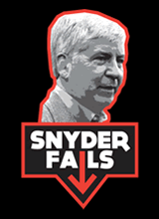
Snyder Math
So where are now?
Retirement costs
Declining enrollments
Change in tax revenue
20% of SAF funding going to community college and higher ed.
Has there really been an increase or decrease in funding since Snyder took office?
Notes:
SO WHERE ARE WE NOW?
Retirement Costs:
These are continually increasing for districts and are mandated under law
Declining enrollment:
In 2003 there were 1.7 million students in Michigan public schools. This year there were 1.5
With funding tied to the students, districts will lose money when they lose students.
Change in Tax revenue:
In 2012, Snyder and the legislature changed the tax policy for business which reduced the amount of state tax revenue going into the SAF
20% of the SAF is now allocated to higher ed and preschool funding.
***These things combined have reduced the amount of state resources that districts receive.****
HAS THERE BEEN AN INCREASE OR DECREASE?
Per-pupil funding has basically stayed flat for the past 4 years. However, with the factors I mentioned earlier, districts are having to get by with much less.
1 BILLION LOST OR $660 PER PUPIL MORE than 4 years ago?
Republicans claim that funding has actually increased by $660 per pupil—
BUT- this goes toward:
Debt service for th school bond loan fund
Money for the Center for Educational Performace and Information
Michigan Virtual University
MPSERS (Retirement fund)
Since this money doesn’t go directly to districts/classrooms, it should not be counted as per-pupil
Democrats claim that Snyder and the Republicans have cut 1 billion from education
2011-400 million was siphoned away from the SAF toward higher ed
Snyder eliminated a business tax which had contributed 600 million to the SAF.
***Technically, education funding wasn’t cut….but it was re-allocated***
No matter how you slice it, or which side you are on—school funding is a complicated issue that needs to be addressed and supported by both parties.

